Slide 1


IMMoRTALS Ecosystem: Environment Definition
Doug Schmidt, Fred Eisele, Jules White
Institute for Software Integrated Systems / EECS Dept. / Vanderbilt University
Motivation and Goals
Stream Processing : Materialized Views [bootstrap]
Adapt the System in response to Environmental Changes
How coordinate software mutation due to changes in hardware resource availability?
Impact Analysis across Modeled Systems
When the specified network bandwidth exceeds the actual bandwidth available, how to adapt?
Time
Fact flow
View Fact
Knowledge
Action Fact
Next Fact
Bootstrap
Material View
Action
Runtime Simulation with Perturbation
Approach
Specification using Models and Ontological Graphs
Extensive traceability enabled by cross-cutting relationships.
Provide additional tooling using GME and other related tools.
Uniform Representation of Artifacts
Timestamped immutable repository of system facts.
Material views of traversable indexed artifacts.
Graph based visualizations.
Reconcile Designed against Realized
Derived data retained in mega-model-graph for traceability and validation including runtime logging.
Empty Scenario
Scenario
Next Scenario
Stop
RDF View
JSON View
Init
DAS
Run Simulation
Select / End
Model Perturbation : Human in the Loop
Model Commit
Candidate Commit
GME Store #1
GME Store #2
TinkerPop3
GME #1
GME #2
Gephi
Runtime Perturbation : Change to Environment
New Package
Scenario
Next Package
Next Scenario
RDF View
Provision
DAS
Sensor
Interfaces, Models and Monitoring for Resource Aware Transformations that Augment the Lifecycle of Systems (IMMoRTALS)
Notes:
The bulk of the work will involve:
Ongoing reconciliation of models : first reconcile manually then automatically
Ongoing development of domain specific languages in sub-domains :
Construction of analysis tools to automate system evolution : first evolve manually then automatically

Slide 2
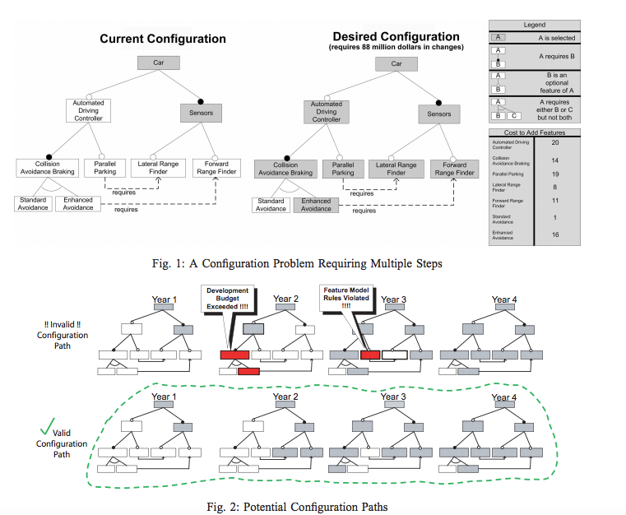
IMMoRTALS Ecosystem: Environment Definition
Doug Schmidt, Fred Eisele, Jules White
Institute for Software Integrated Systems / EECS Dept. / Vanderbilt University
Motivation and Goals
CURE: Constraint-based Conflict Resolution Optimization
Conflicts Between Models / Decisions are Inevitable
How do you handle real-world conflicts between multiple goals?
How do you optimally resolve conflicts across complex constraint systems?
Resolution Not Always Possible in a Single Step
Reaching a valid configuration / state may take multiple steps and require ensuring intermediate constraints are met.
Approach
Constraint Resolution is Framed as an Optimization Problem
Solve for optimal set of changes to generate valid configurations
Define real-valued objectives to maximize / minimize (e.g., memory, cost, total changes)
Ability to Optimally Plan Evolution Between Configurations
Plan evolution over a series of epochs and provide changing “point constraints” to adhere to over time
Evolve from invalid to valid states or from less optimal to more optimal states
Define objectives for optimization that vary over time to ensure optimal timing of changes
Jules White, David Benavides, Tripti Saxena, Brian Dougherty, Douglas C. Schmidt, Jose A. Galindo, Evolving Feature Model Configurations in Software Product Lines, Journal of Software and Systems, Volume 87, pp. 119-136, 2014
Jules White, David Benavides, Douglas C. Schmidt, Pablo Trinidad, Antonio Ruiz-Cortes, Brian Doughtery, Automated Diagnosis of Feature Model Configurations, Journal of Systems and Software, Volume 83, Number 7, pgs. 1094-1107, July, 2010
Jules White, Brian Doughtery, Douglas C. Schmidt, Selecting Highly Optimal Architectural Feature Sets with Filtered Cartesian Flattening, Journal of Systems and Software, August 2009, Volume 82, Number 8, Pages 1268-1284
Step 1
Memory Budget Exceeded
Step 2
Configuration Constraints Violated
Step 3
Step 4
Interfaces, Models and Monitoring for Resource Aware Transformations that Augment the Lifecycle of Systems (IMMoRTALS)
Notes:
The bulk of the work will involve:
Ongoing reconciliation of models : first reconcile manually then automatically
Ongoing development of domain specific languages in sub-domains :
Construction of analysis tools to automate system evolution : first evolve manually then automatically

